Slide 1
I2C

Slide 2
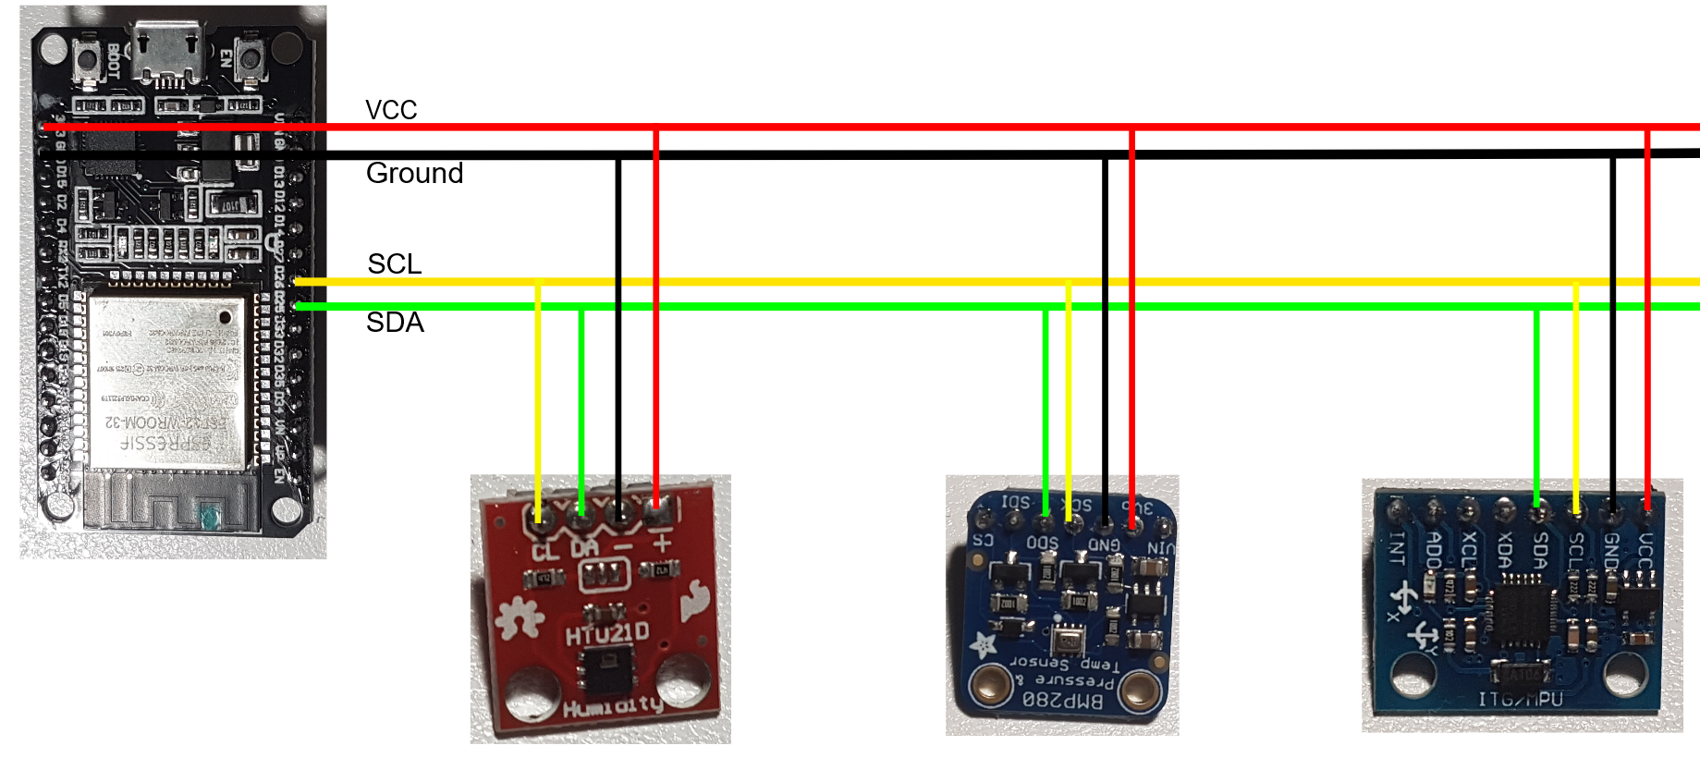
I2c = iic = Inter integrated circuit
Only 2 data lines required
Multiple devices on the same bus
An I2C circuit consists of one master and many slaves

Slide 3
ESP32 I2C SUPPORT
2 I2C busses
Either bus can act as a master or slave
Configurable GPIO for SDA and SCL

Slide 4
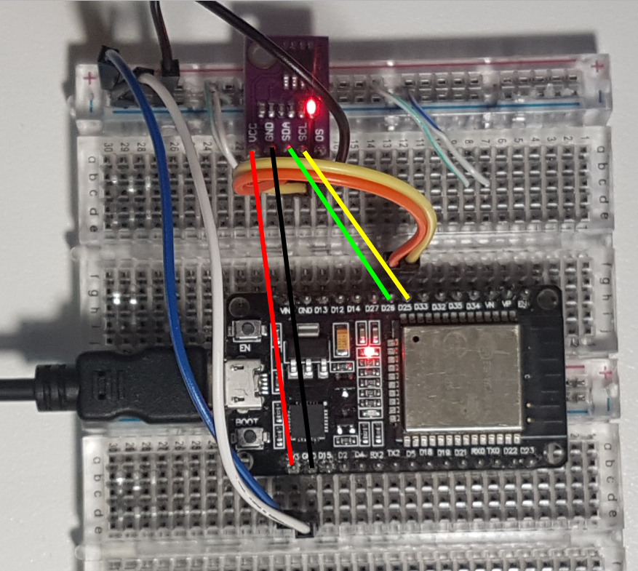

Slide 5
ESP32 What you need to know
Each device has an address
Each device has one or more registers
Some registers can be read from, others can be written to
Sometimes you first need to write to a register as a command before doing a read
Sometimes you need to read or write more than one byte at a time
The specifics on how to communicate to the component is defined in the datasheet of that component

